Slide 1
State of Obesity and Selected Social Determinants of Health in the United States
The Sassy Stingrays
Daniel Byrne
Erin Cullen
Steven Orn
Greg Rosen
Vilma Santos

Slide 2
PROJECT GOAL
Allow users to explore how various social determinants – such as economic status and availability of restaurants – might affect the incidence of obesity in the United States

Slide 3
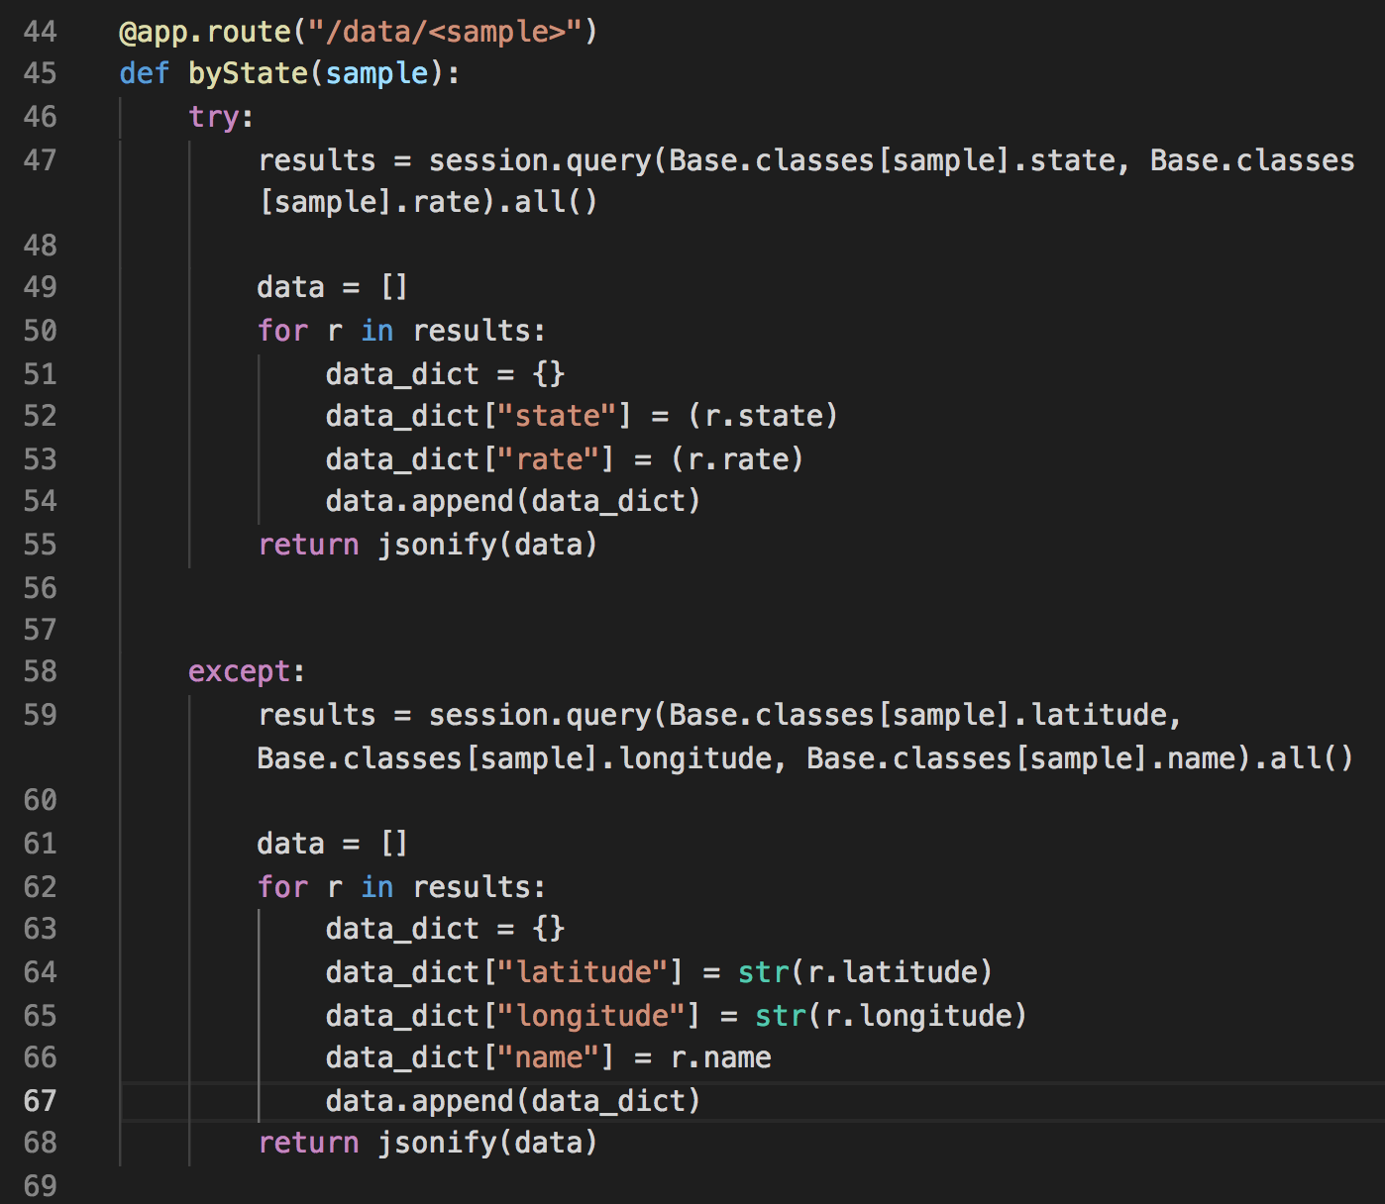
Used Python’s Flash Framework to build various routes on the site.
Data was returned from the sqlite database with either a latitude and longitude or a state name and a rate.

Slide 4
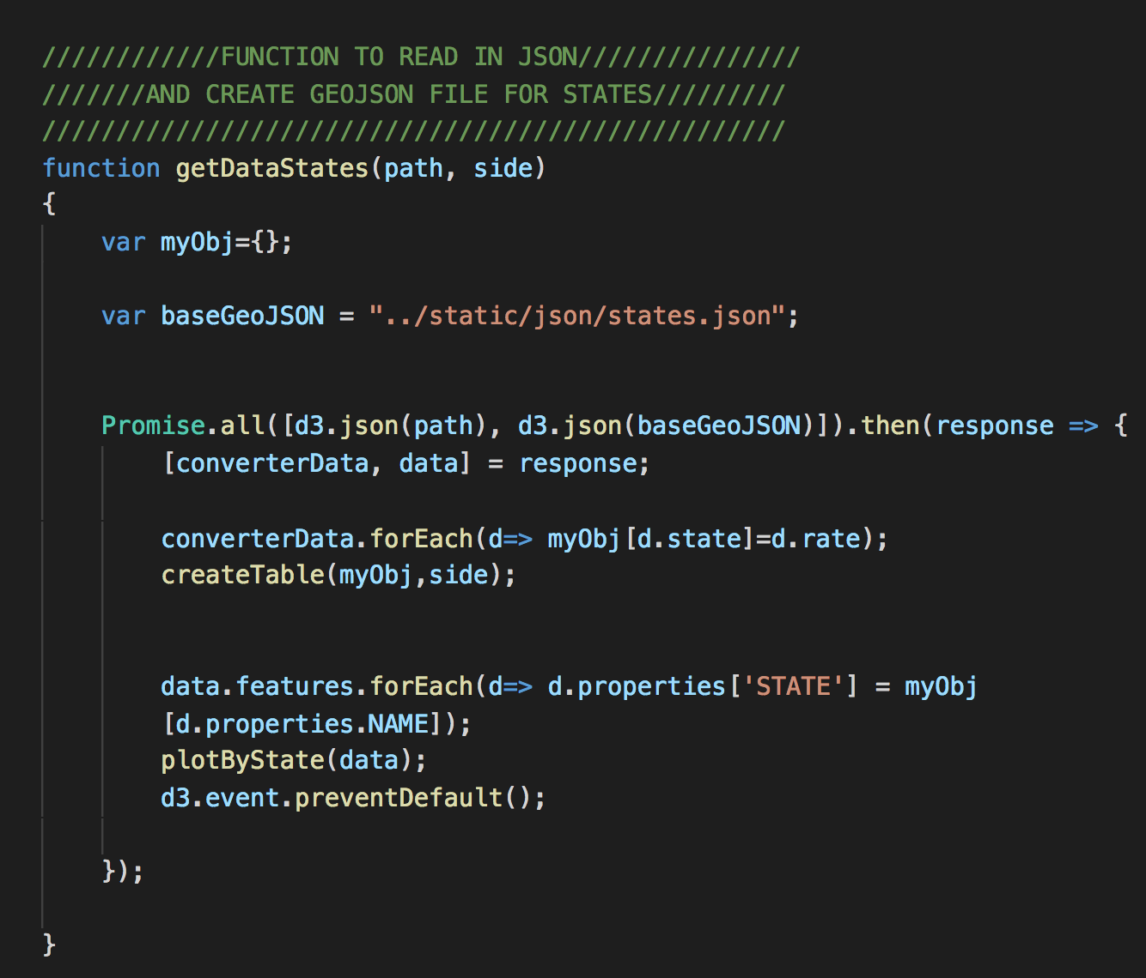
Used JavaScript’s leaflet library to graph the data on a map of the US.
We used a GEO JSON file to get the outlines of each state.

Slide 5
SCROLLAMA
We used Scrollama as our additional JS library
Scrollama is a modern & lightweight JavaScript library for scrollytelling using IntersectionObserver in favor of scroll events.

Slide 6
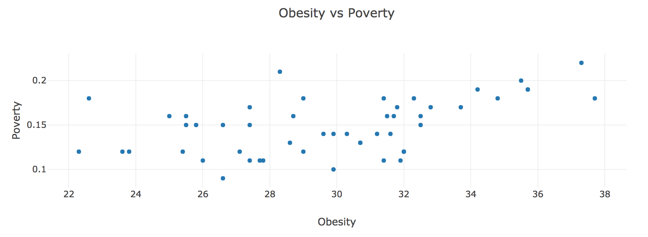
FINDINGS
There is an inverse relationship between obesity and poverty

Slide 7
LIMITATIONS

